Slide 1
PHYS 304: Lecture 20 (Intro to) Quantum Mechanics
Sept-Dec 2021 Edition
Jeff Young
brimacombe Rm 278, young@phas.ubc.ca

Slide 2
Review of key points from last lecture
We talked about the relationship of the symmetries that leave the potential function invariant under coordinate transformation, and the degeneracy of energy eigen states: no symmetry, no degeneracy, the more symmetry, the more degeneracy, roughly speaking.
We discussed how our 3D infinite well potential solutions relate to atomic “orbitals” (essentially the magnitude of the distinct eigen functions) and the energy of photons emitted by excited atoms (essentially the difference of energy eigen values between excited states and lower lying states of the electron).
We discussed how electrons might be induced to make transitions from one “stationary” state to another, via interaction (collisions) with other entities (electrons, photons).

Slide 3

Today
Find the angular contributions to the solution of the central potential TISE.
Discuss properties of the complete eigen states of the spherically-symmetric potential problem when the potential takes the form $V\left(\vec{r}\right)=V\left(\left|\vec{r}\right|\right)=V\left(r\right)∝\frac{1}{r}$. (will defer discussion of what approximations go into using ${\hat{H}}_{hydrogen electron}≈\frac{\hat{\vec{p}}⋅\hat{\vec{p}}}{2m}−\frac{e^{2}}{4πε_{0}}\frac{1}{r}$)

Slide 4
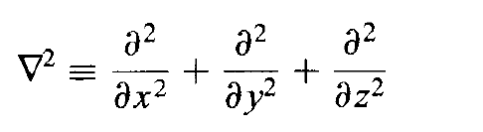
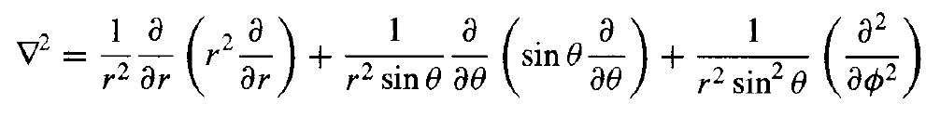
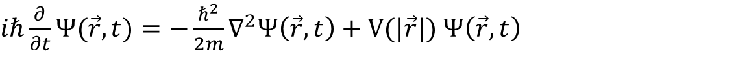
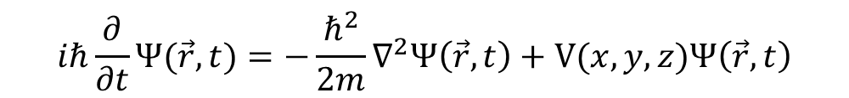
Solving the Schrödinger Equation
$$iℏ\frac{∂}{∂t}Ψ(\vec{r},t)=−\frac{ℏ^{2}}{2m}∇^{2}Ψ\left(\vec{r},t\right)+V(x,y,z)Ψ\left(\vec{r},t\right)$$
$iℏ\frac{∂}{∂t}Ψ\left(x,y,z,t\right)=−\frac{ℏ^{2}}{2m}∇^{2}Ψ\left(x,y,z,t\right)+V(x,y,z)$ $Ψ(x,y,z,t)$
$iℏ\frac{∂}{∂t}Ψ(\vec{r},t)=−\frac{ℏ^{2}}{2m}∇^{2}Ψ\left(\vec{r},t\right)+V(|\vec{r}|)$ $Ψ\left(\vec{r},t\right)$
$iℏ\frac{∂}{∂t}Ψ(r,θ,φ,t)=−\frac{ℏ^{2}}{2m}∇^{2}Ψ\left(r,θ, φ,t\right)+V(r)$ $Ψ(r,θ,φ,t)$

Slide 5
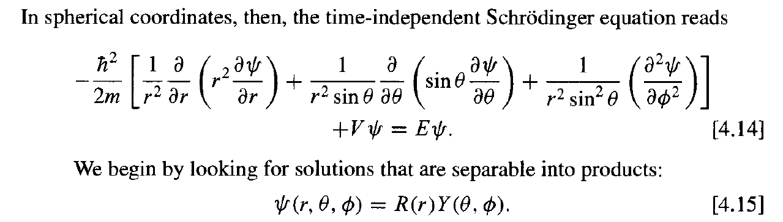
Solving the Schrödinger Equation

Slide 6
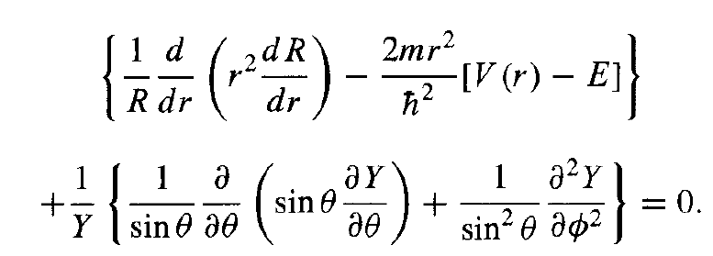
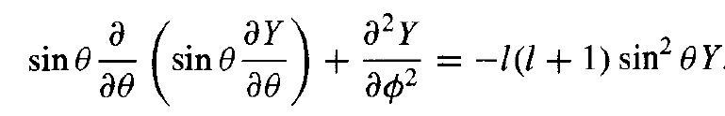
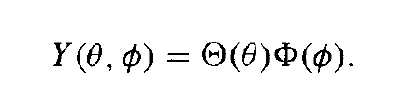
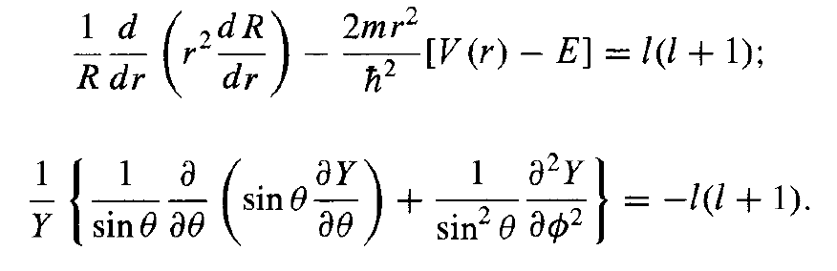
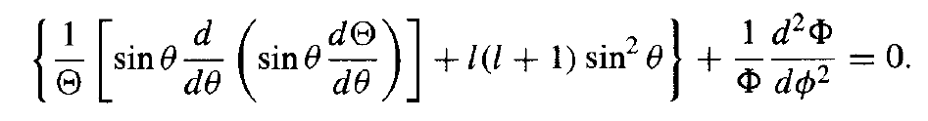
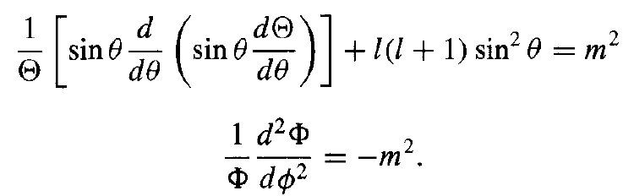
Solving the Schrödinger Equation
The angular equation

Slide 7



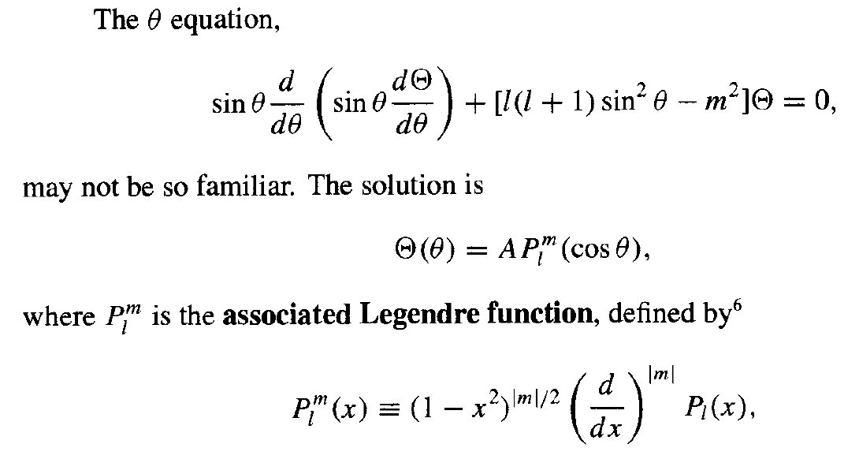
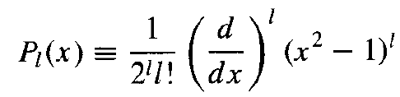
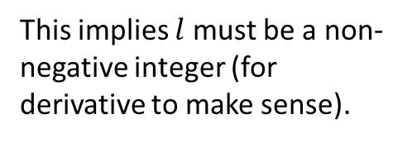
Solving the Schrödinger Equation
Also implies maximum $\left|m\right|=l$.
This implies $l$ must be a non-negative integer (for derivative to make sense).

Slide 8
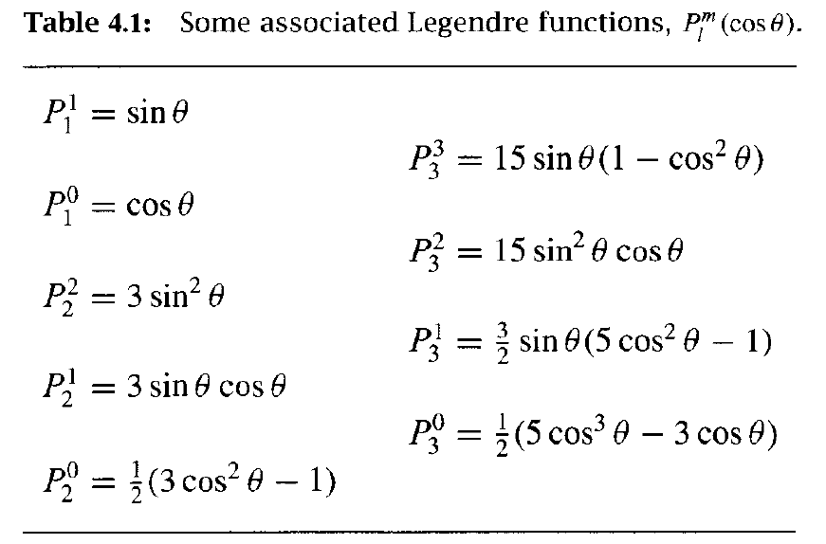
Full angular solution

Slide 9
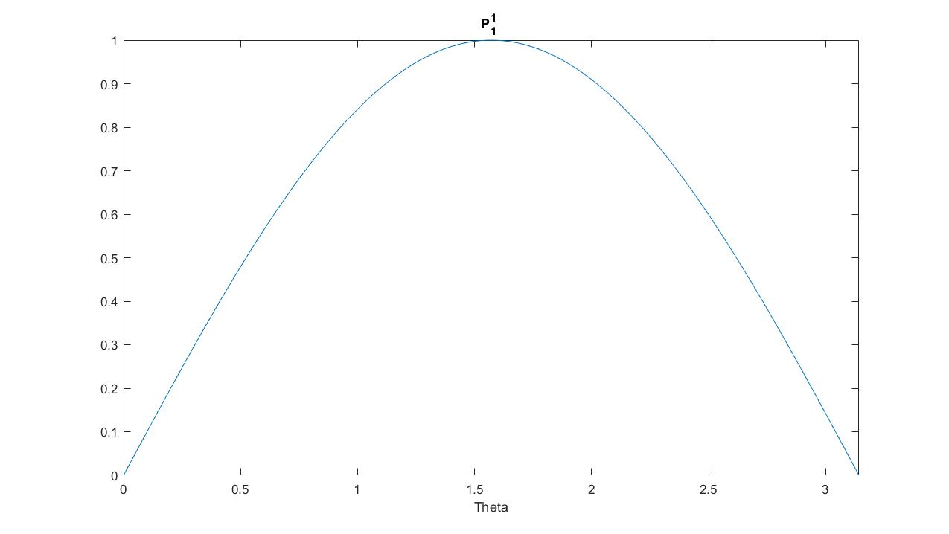
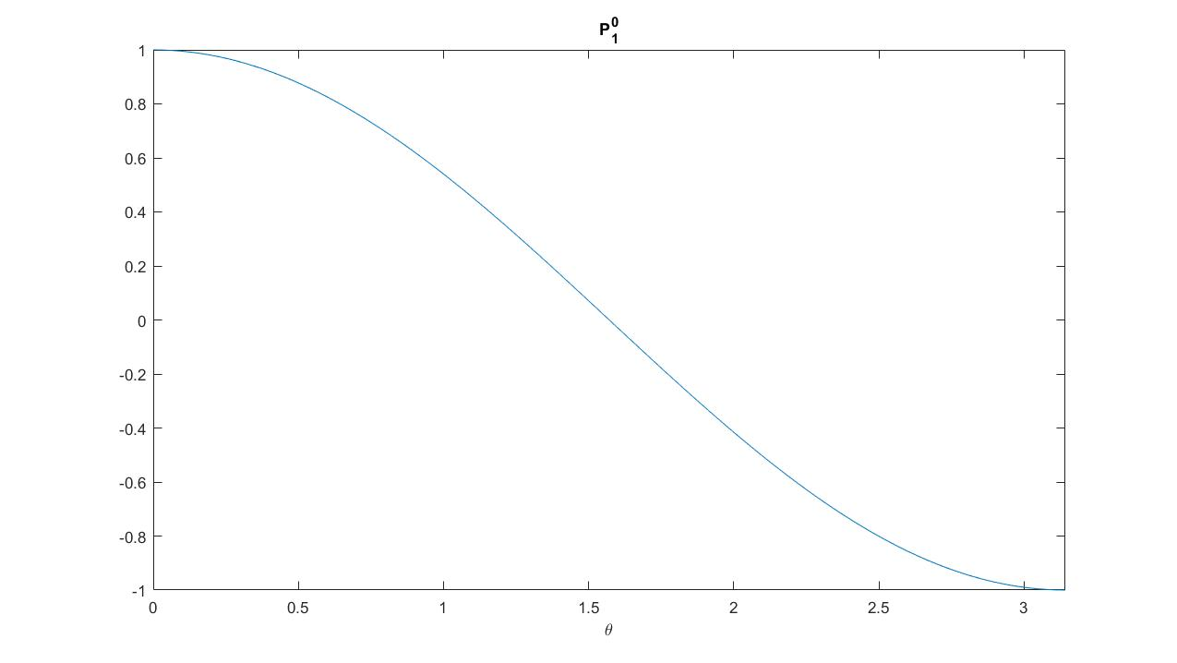


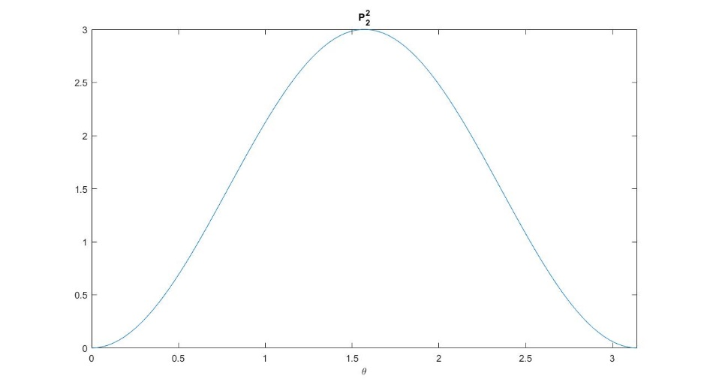
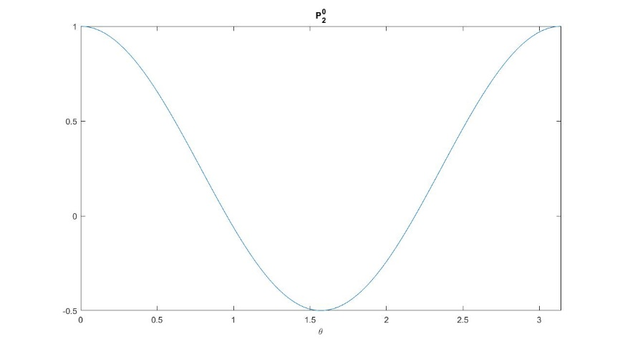

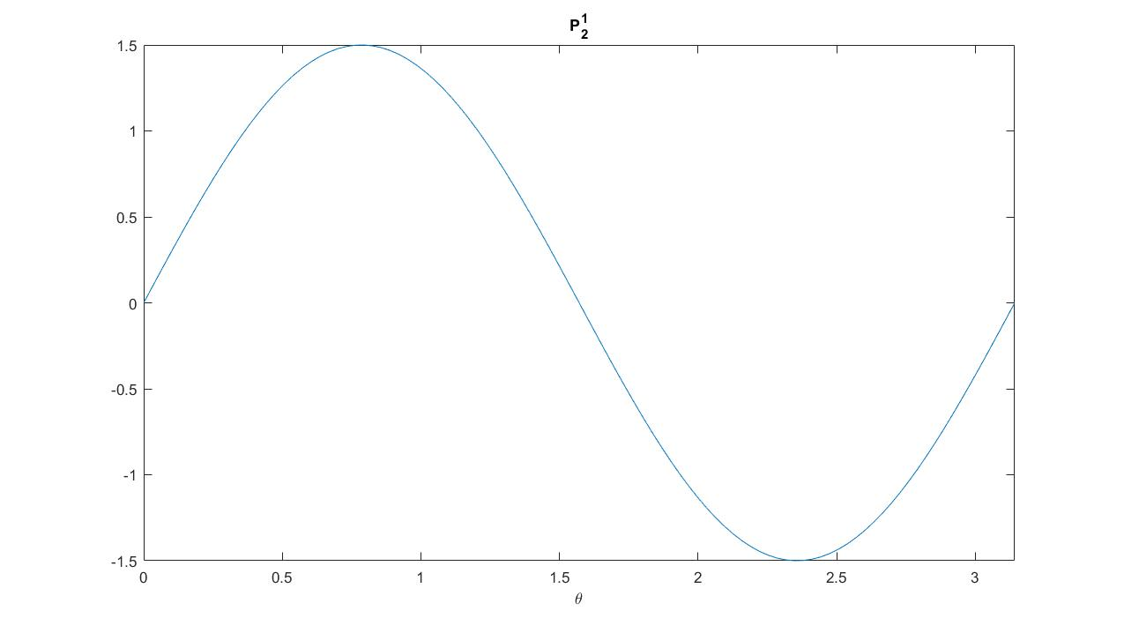


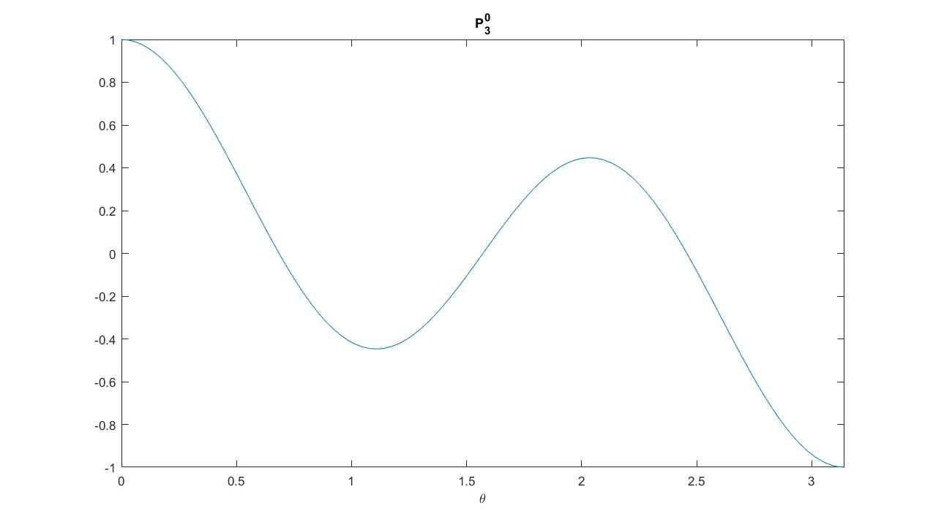




POLL#2: How many nodes are there between 0 <$θ<$ $π$ in $P_{l}^{m}$?
l
m
l+m
l-m
l+|m|
l-|m|
P₂⁻¹=
0 $θ$ $π$
0 $θ$ $π$

Slide 10
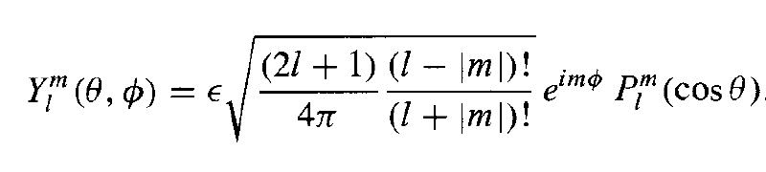
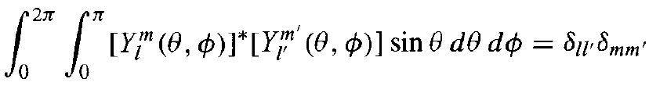
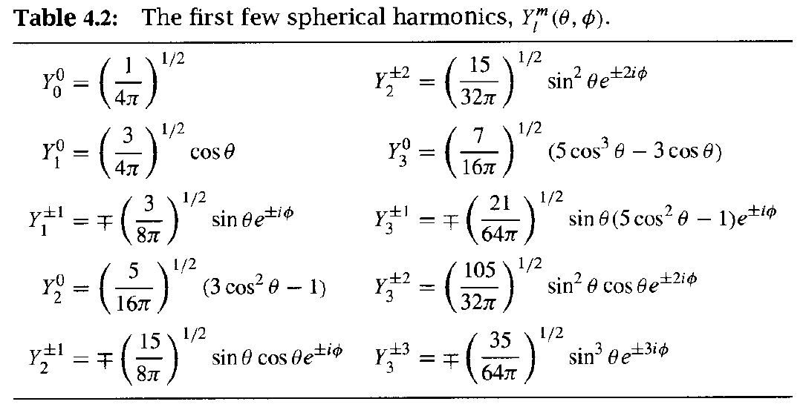
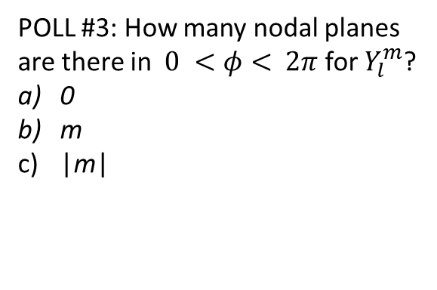
Gory details!
POLL #3: How many nodal planes are there in $0 <φ<$ $2π$ for $Y_{l}^{m}$?
0
m
|m|

Slide 11
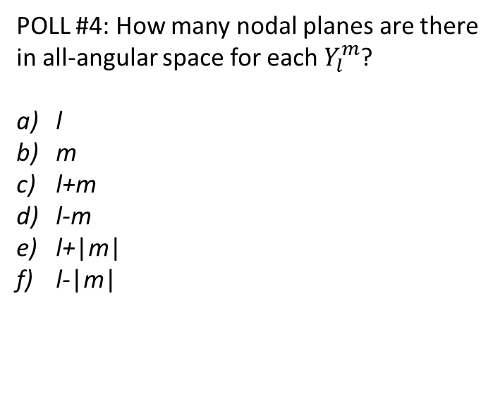
More node accounting
POLL #4: How many nodal planes are there in all-angular space for each $Y_{l}^{m}$?
l
m
l+m
l-m
l+|m|
l-|m|

Slide 12
Pause
How do any of these spherical harmonic functions depend on the exact form of the radially symmetric potential?
They don’t, explicitly. They will indirectly connect via the shared constant identified in the first separation of variables step in the derivation, but there is no explicit V(r) dependence in these spherical harmonics.
Pause: what do we know (and what do we not know) so far about the solutions of the time-independent SE for a particle that experiences a spherically symmetric potential?
We know precisely that their theta and phi dependence is constrained to functions with shapes that depend only on two integers, l and m, where for any l >=1, there are 2l+1 allowed values of m: -l, -l+1,..0,1,…l, and the total number of nodes, split between the theta and phi degrees of freedom is equal to l, and the number of nodes in the phi degree of freedom is |m|
We know nothing about the radial part of the solution.
Notes:
They don’t explicitly. They will indirectly connect via the shared constant identified in the first separation of variables step in the derivation, but there is no explicit V(r) dependence in these spherical harmonics.
We know precisely that their theta and phi dependence is constrained to functions with shapes that depend only on two integers, l and m, where for any l, there are 2l+1 allowed values of m: -l, -l+1,..0,1,…l, and the total number of nodes, split between the theta and phi degrees of freedom is equal to l, and the number of nodes in the phi degree of freedom is |m|
We know nothing about the radial part of the solution.

Slide 13
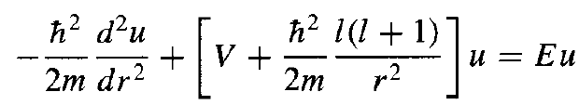

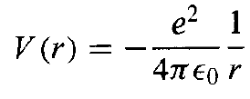
The radial part of the solution
The solution of the radial equation (remember it?)?
where
Before we can make any further, what do we need to know?
The hydrogen atom.
Notes:
Note that they are connected only by l, not m
Bottom left still as a function of V(r), right bottom is specifically for the Coulomb potential

Slide 14
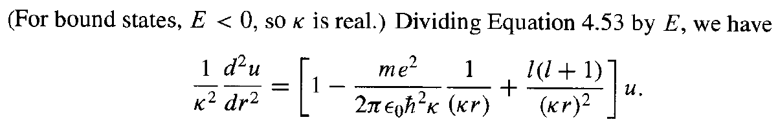
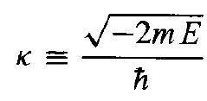
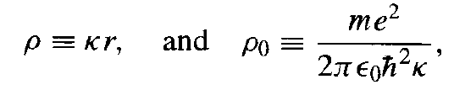
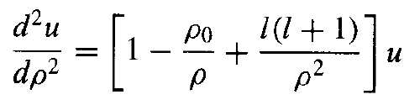
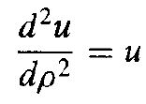


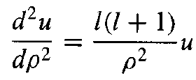




The radial part of the solution
where
With
As $ρ→∞$
;
;
As $ρ→$0
;
Notes:
Similar to HO, where assumed a functional form that includes a polynomial, and do a power series expansion of that polynomial to get a recursion formula for it’s coefficients. Just like HO, they can’t be arbitrarily large, so specific sets of coeffiecients dictated by requirement for there to be a maximum power in a given polynomial solution. j=0 corresponds to the constant, j=1 to the linear term in rho, etc.

Slide 15





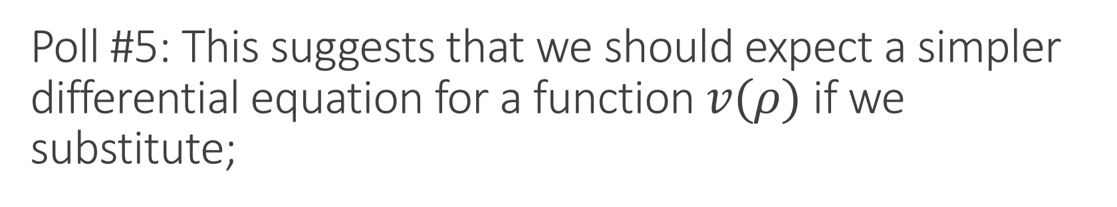

Poll #5: This suggests that we should expect a simpler differential equation for a function $v(ρ)$ if we substitute;
a)
b)
c)
d)
As $ρ→∞$
+
As $ρ→$0
-

Slide 16
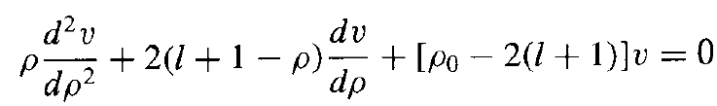
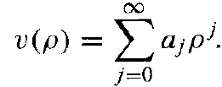
The radial part of the solution
&
Remind you of any other equation we have encountered?
Assume

Slide 17
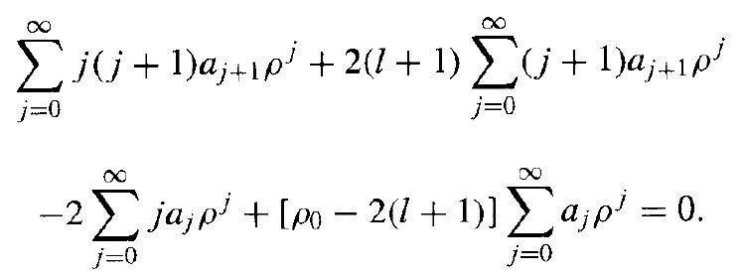
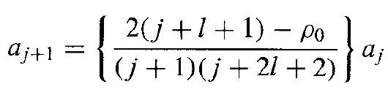
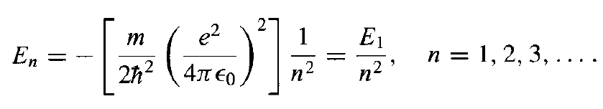
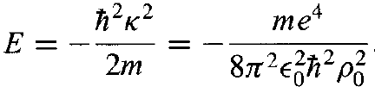
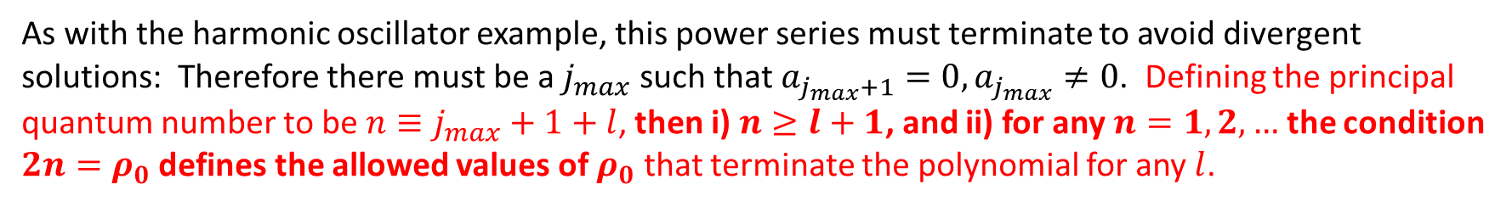
The radial part of the solution
Equating the coefficients of like powers yields a recursion relation for the coefficients:
As with the harmonic oscillator example, this power series must terminate to avoid divergent solutions: Therefore there must be a $j_{max}$ such that $a_{j_{max}+1}=0,a_{j_{max}}≠0$. Defining the principal quantum number to be $n≡j_{max}+1+l$, then i) $n≥l+1$, and ii) for any $n=1,2,…$ the condition $2n=ρ_{0}$ defines the allowed values of $ρ_{0}$ that terminate the polynomial for any $l$.
But $ρ_{0}$ is directly related to the allowed eigen energies in the problem:
Notes:
Note, n=N+l (Eqn. 2.67) where N is the order of the radial polynomial in the expansion, so N-1 is equal to the number of nodes in the radial function R, which is therefore = n-l-1 (check with Fig. 4.7

Slide 18


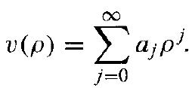
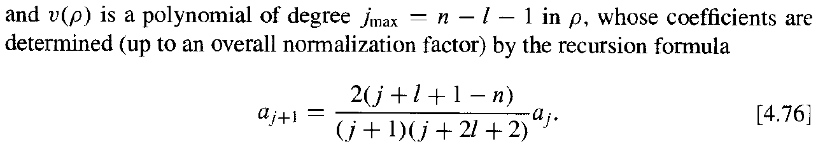
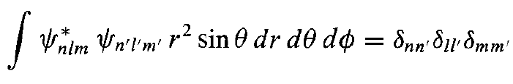

The full set of eigen functions (n, l, m)!
where the normalization has to be determined for each eigen state by adjusting $a_{0}$.

Slide 19
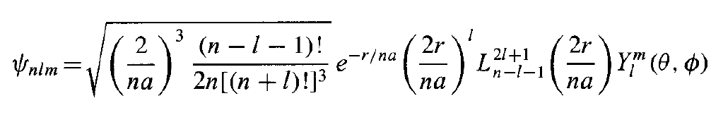
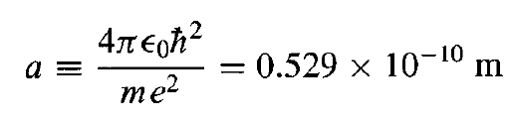
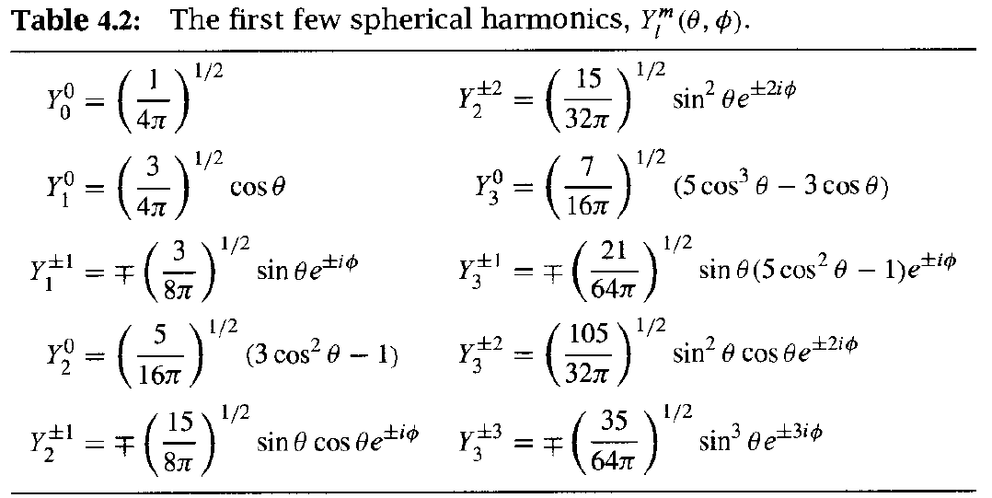

The full eigen functions: spherical potential
You can always look up or numerically evaluate the actual special functions, but the key things you must understand are the relationships/dependencies between the integers n, l, and m, the associated degeneracies, and the number of nodes in each of the degrees of freedom.
, the Bohr radius

